Slide 1

Hospital mortality
Death of patient in hospital

Slide 2

Why Should we care about hospital mortality?
Patient Safety: Lowering hospital mortality rates indicates better patient care, reducing the risk of adverse events and medical errors that could lead to fatalities.
Quality of Healthcare: Monitoring and improving hospital mortality rates reflect the overall effectiveness and excellence of healthcare services provided by hospitals.
Public Trust: Decreasing hospital mortality rates enhances public trust in the healthcare system, assuring patients and their families of the reliability and competence of medical facilities.
Economic Impact: By reducing hospital mortality, healthcare systems can potentially save significant costs associated with prolonged hospital stays, intensive treatments, and legal expenses related to medical malpractice.
Health Outcomes: Lowering hospital mortality rates directly correlates with better health outcomes for patients, leading to increased life expectancy and improved quality of life for individuals and communities.

Slide 3
Patient telemetry
Patient Demographics:
Age: The patient population ranges from 19 to 99 years old, with a mean age of 74. Half of the patients are under 77 years old.
Body Mass Index (BMI): BMI ranges from 13 to 104, with a mean of 30. Normal 18-24.
Cardiovascular Metrics:
Heart Rate: Ranges from 36 to 135, with a mean and median around 84.
Systolic Blood Pressure (SBP): Ranges from 75 to 203, with mean and median around 117, where normal is below 120 mmHg.
Diastolic Blood Pressure (DBP): Ranges from 24 to 107, with mean and median around 59, where normal is below 80 mmHg.
Respiratory Rate: Ranges from 11 to 40, with mean and median around 20.
Temperature: Ranges from 33°F to 39°F, with mean and median around 36°F, within the normal range of 36°F to 37°F.
Spo2:
Spo2 ranges from 75 to 100, with a median around 97. Below 90 is considered concerning.

Slide 4
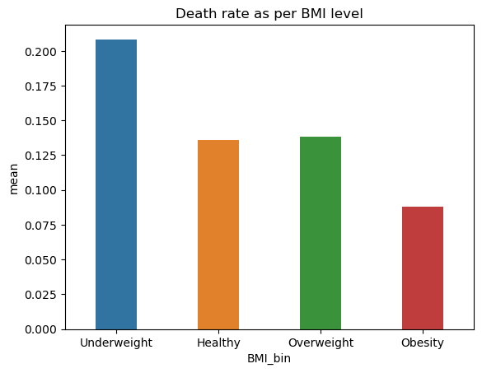
Does BMI level effect mortality ?
- Underweight patients have the highest mortality rate (around 20%), typically older (median age 83).
- Healthy-weight and overweight patients have similar mortality rates (around 13%).
- Surprisingly, obese patients have lower mortality rates (around 8%), with a median age of 70.
- Statistical analysis confirms BMI's significant impact on mortality (10% significance level), suggesting it as a meaningful predictor of mortality outcomes.

Slide 5
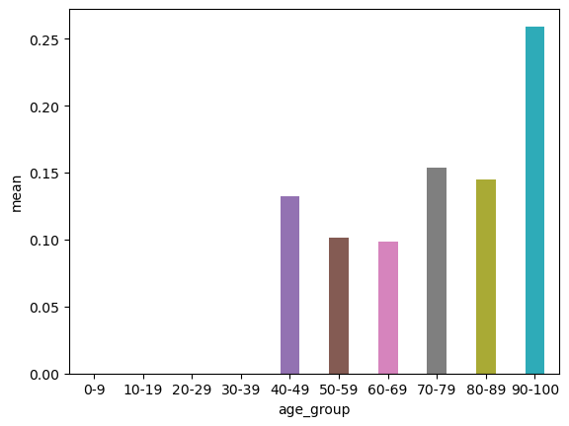
Does Age effect mortality ?
- Mortality is significantly higher (over 15% on average) for individuals aged 70 and above.
- Interestingly, mortality is lower for individuals aged 50-70 compared to those aged 40-50.
- There's no significant association between age group and mortality based on statistical analysis.
- However, there's a significant difference in the mean age between survivors and deceased patients.

Slide 6
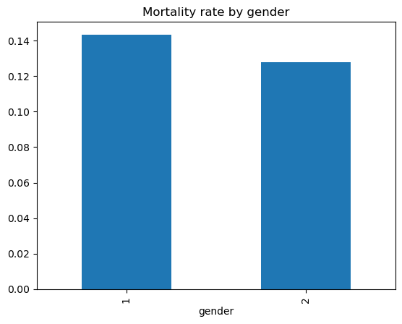
Is there any significant association between gender and mortality ?
The patient population is almost evenly split between females (47%) and males (52%).
While females have a slightly higher mortality rate (14%) compared to males (12%), statistical analysis finds no significant association between gender and mortality.

Slide 7
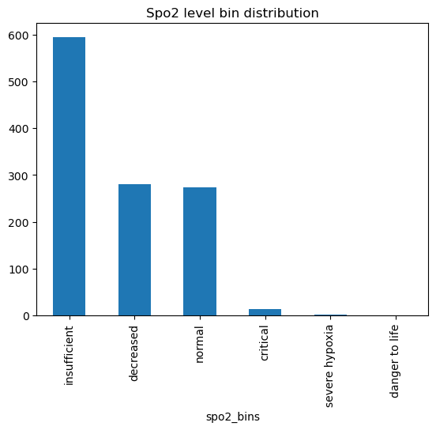
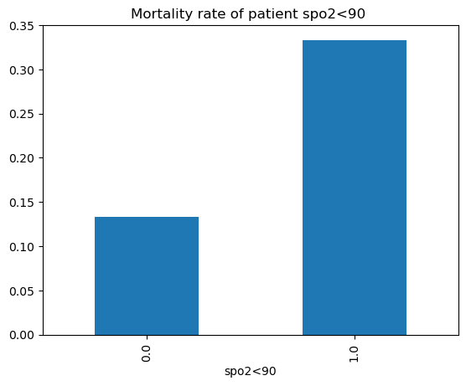
Effect of Spo2 on Mortality
- Severe hypoxia (<80% SpO2) is associated with a 100% mortality rate due to irreversible tissue damage.
- Critical SpO2 levels (80-90%) correlate with a mortality rate of around 28%, indicating the significant impact of even small decreases in oxygen saturation.
- Mortality remains relatively high (14.9%) at decreased SpO2 levels (90-95%), emphasizing the risk of compromised oxygenation.
- Insufficient SpO2 levels (95-98%) result in a moderate mortality rate of approximately 12.9%.
- Conversely, normal SpO2 levels (>98%) are linked to a minimal mortality rate of 0.124%.
- Mortality rate is significantly higher (33%) when SpO2 is <90 compared to 13% when SpO2 is >90.

Slide 8
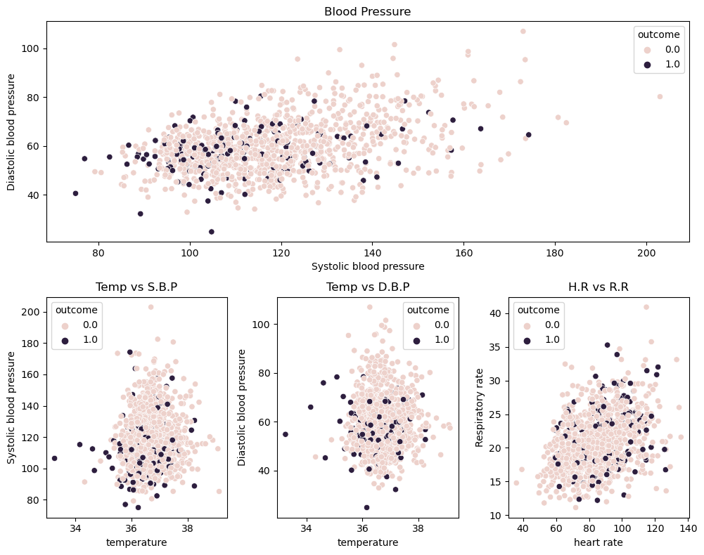
Relationship between Vital Signs and Mortality
- The plot doesn't provide clear conclusions except for a few instances.
- Mortality is high when Systolic blood pressure is below 80 and Diastolic blood pressure is below 60.
- Patients with Systolic blood pressure below 120 and temperature below 34 also experience high mortality.
- Patients with Diastolic blood pressure below 40 and heart rate below 60 have a high mortality rate.
- Mortality is also high when Systolic blood pressure is below 40 and Respiratory Rate is less than 25.
- High mortality is observed if SpO2 is below 85 and temperature is less than 37.
- Similarly, high mortality is seen if SpO2 is below 85 and Respiratory Rate is less than 25.

Slide 9
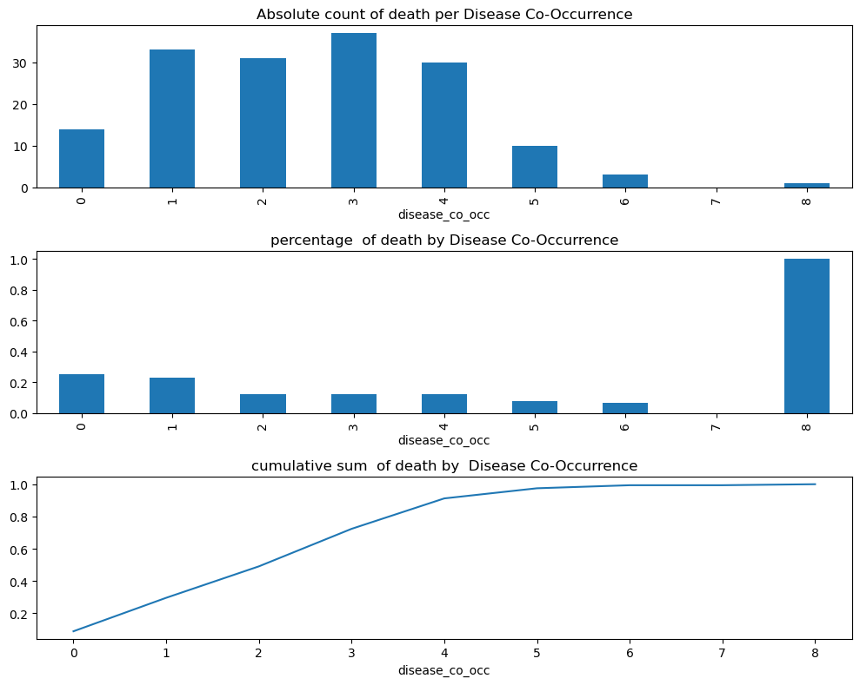
Analysis based on disease co-occurance
- Most patients with three disease co-occurrences died, indicating a higher mortality rate with multiple diseases.
- Rare but severe: All patients with eight disease co-occurrences had 100% mortality, emphasizing the critical impact of complex disease combinations.
- Single disease mortality rate is 25%, highlighting significant consequences even with a single disease.
- The average mortality rate for patients with 1-4 diseases is 32%, showing a notable impact of disease co-occurrences on mortality.
- 91% of deaths occurred in patients with four or fewer diseases, underlining the significance of a smaller number of diseases in mortality rates.

Slide 10
Q&A

